Slide 1
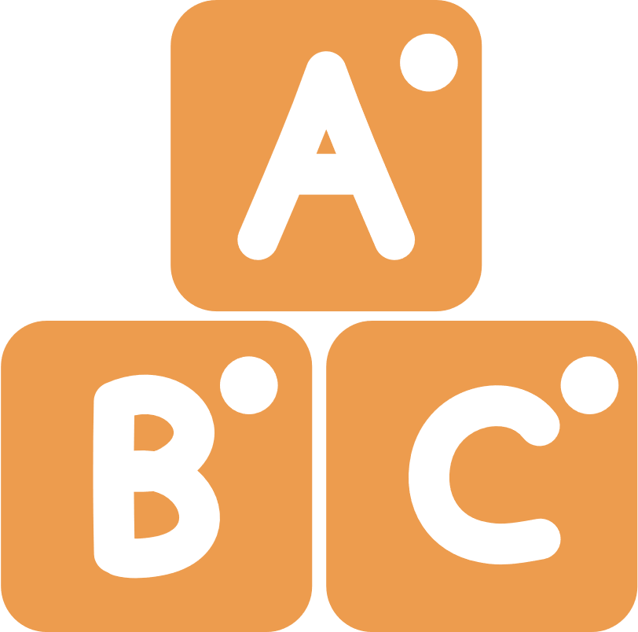
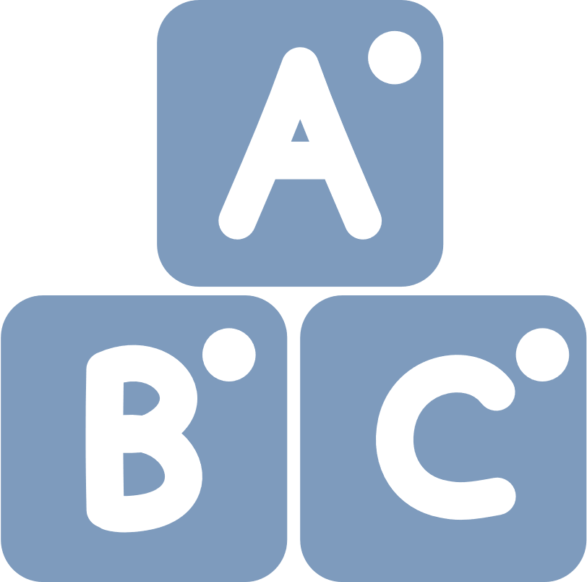
Consonant Sounds
NYC PUBLIC SCHOOLS
LITERACY COLLABORATIVE
An Interactive Activity for Children and their Families

Slide 2
DIRECTIONS
CONSONANT SOUNDS
Sit with your child and click on the card and listen to the letter(s), keyword, and sound.
Repeat the letter(s), keyword, and sound for your child and ask them to repeat it after you.
Ask them, “what words can you think of that have these consonants?”

Slide 3
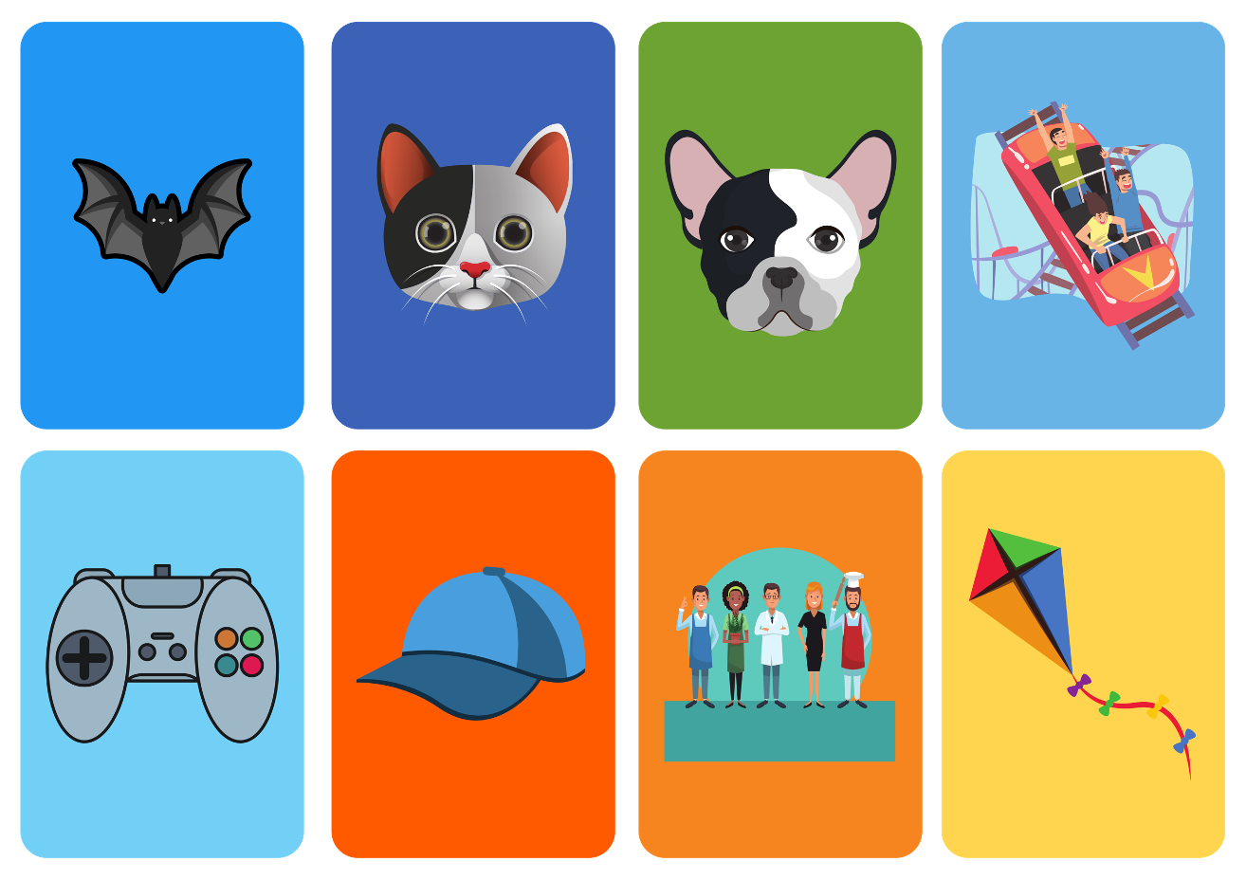
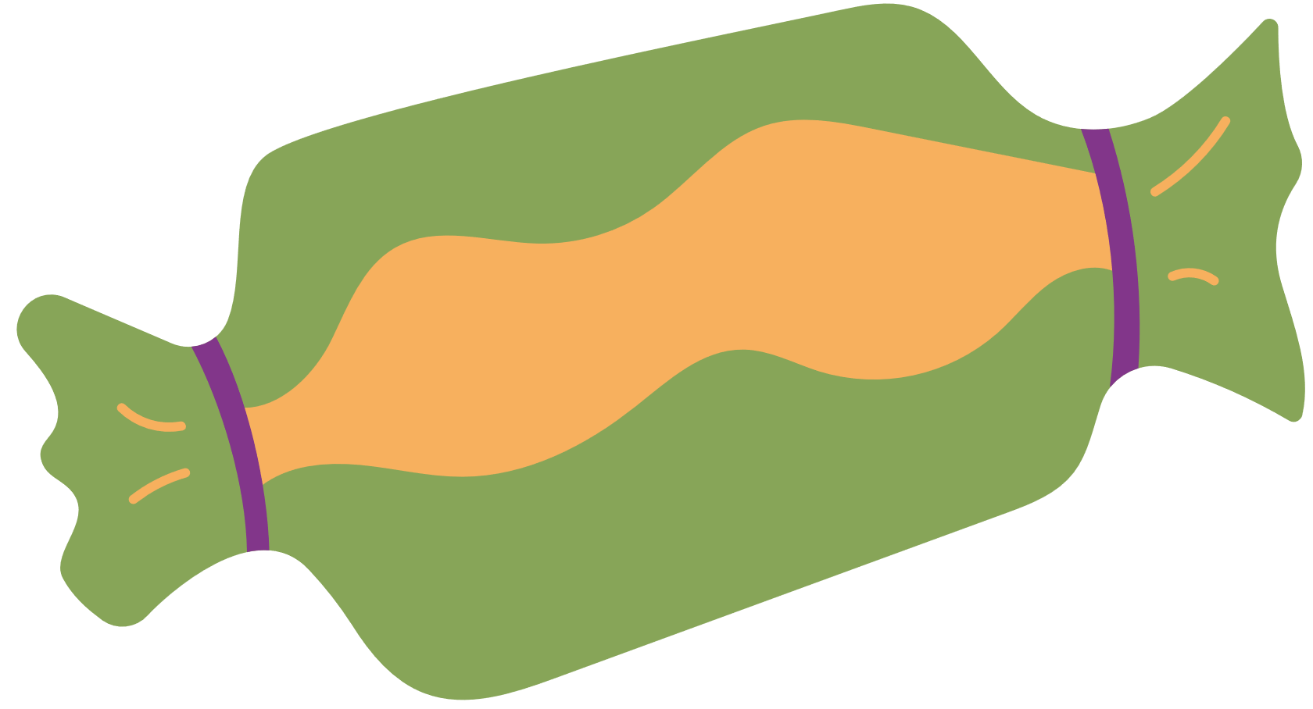
Page 1

Slide 4
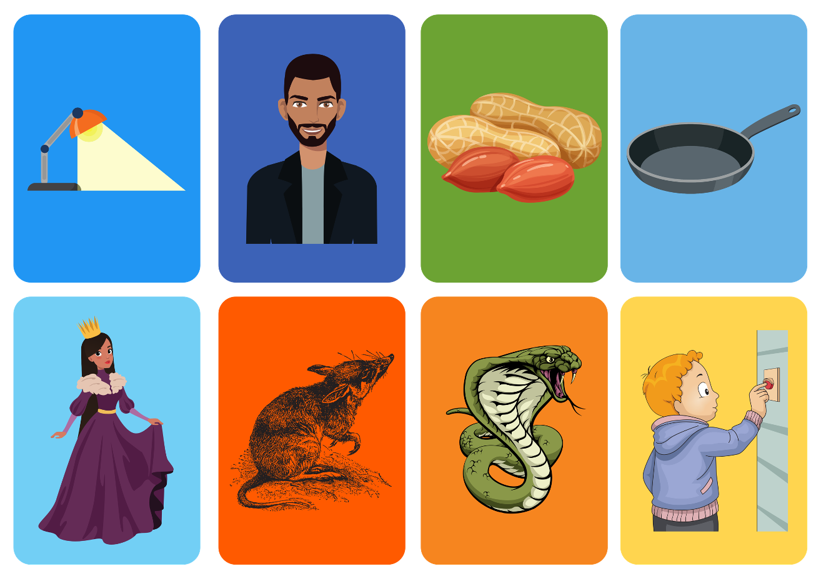
Page 2

Slide 5
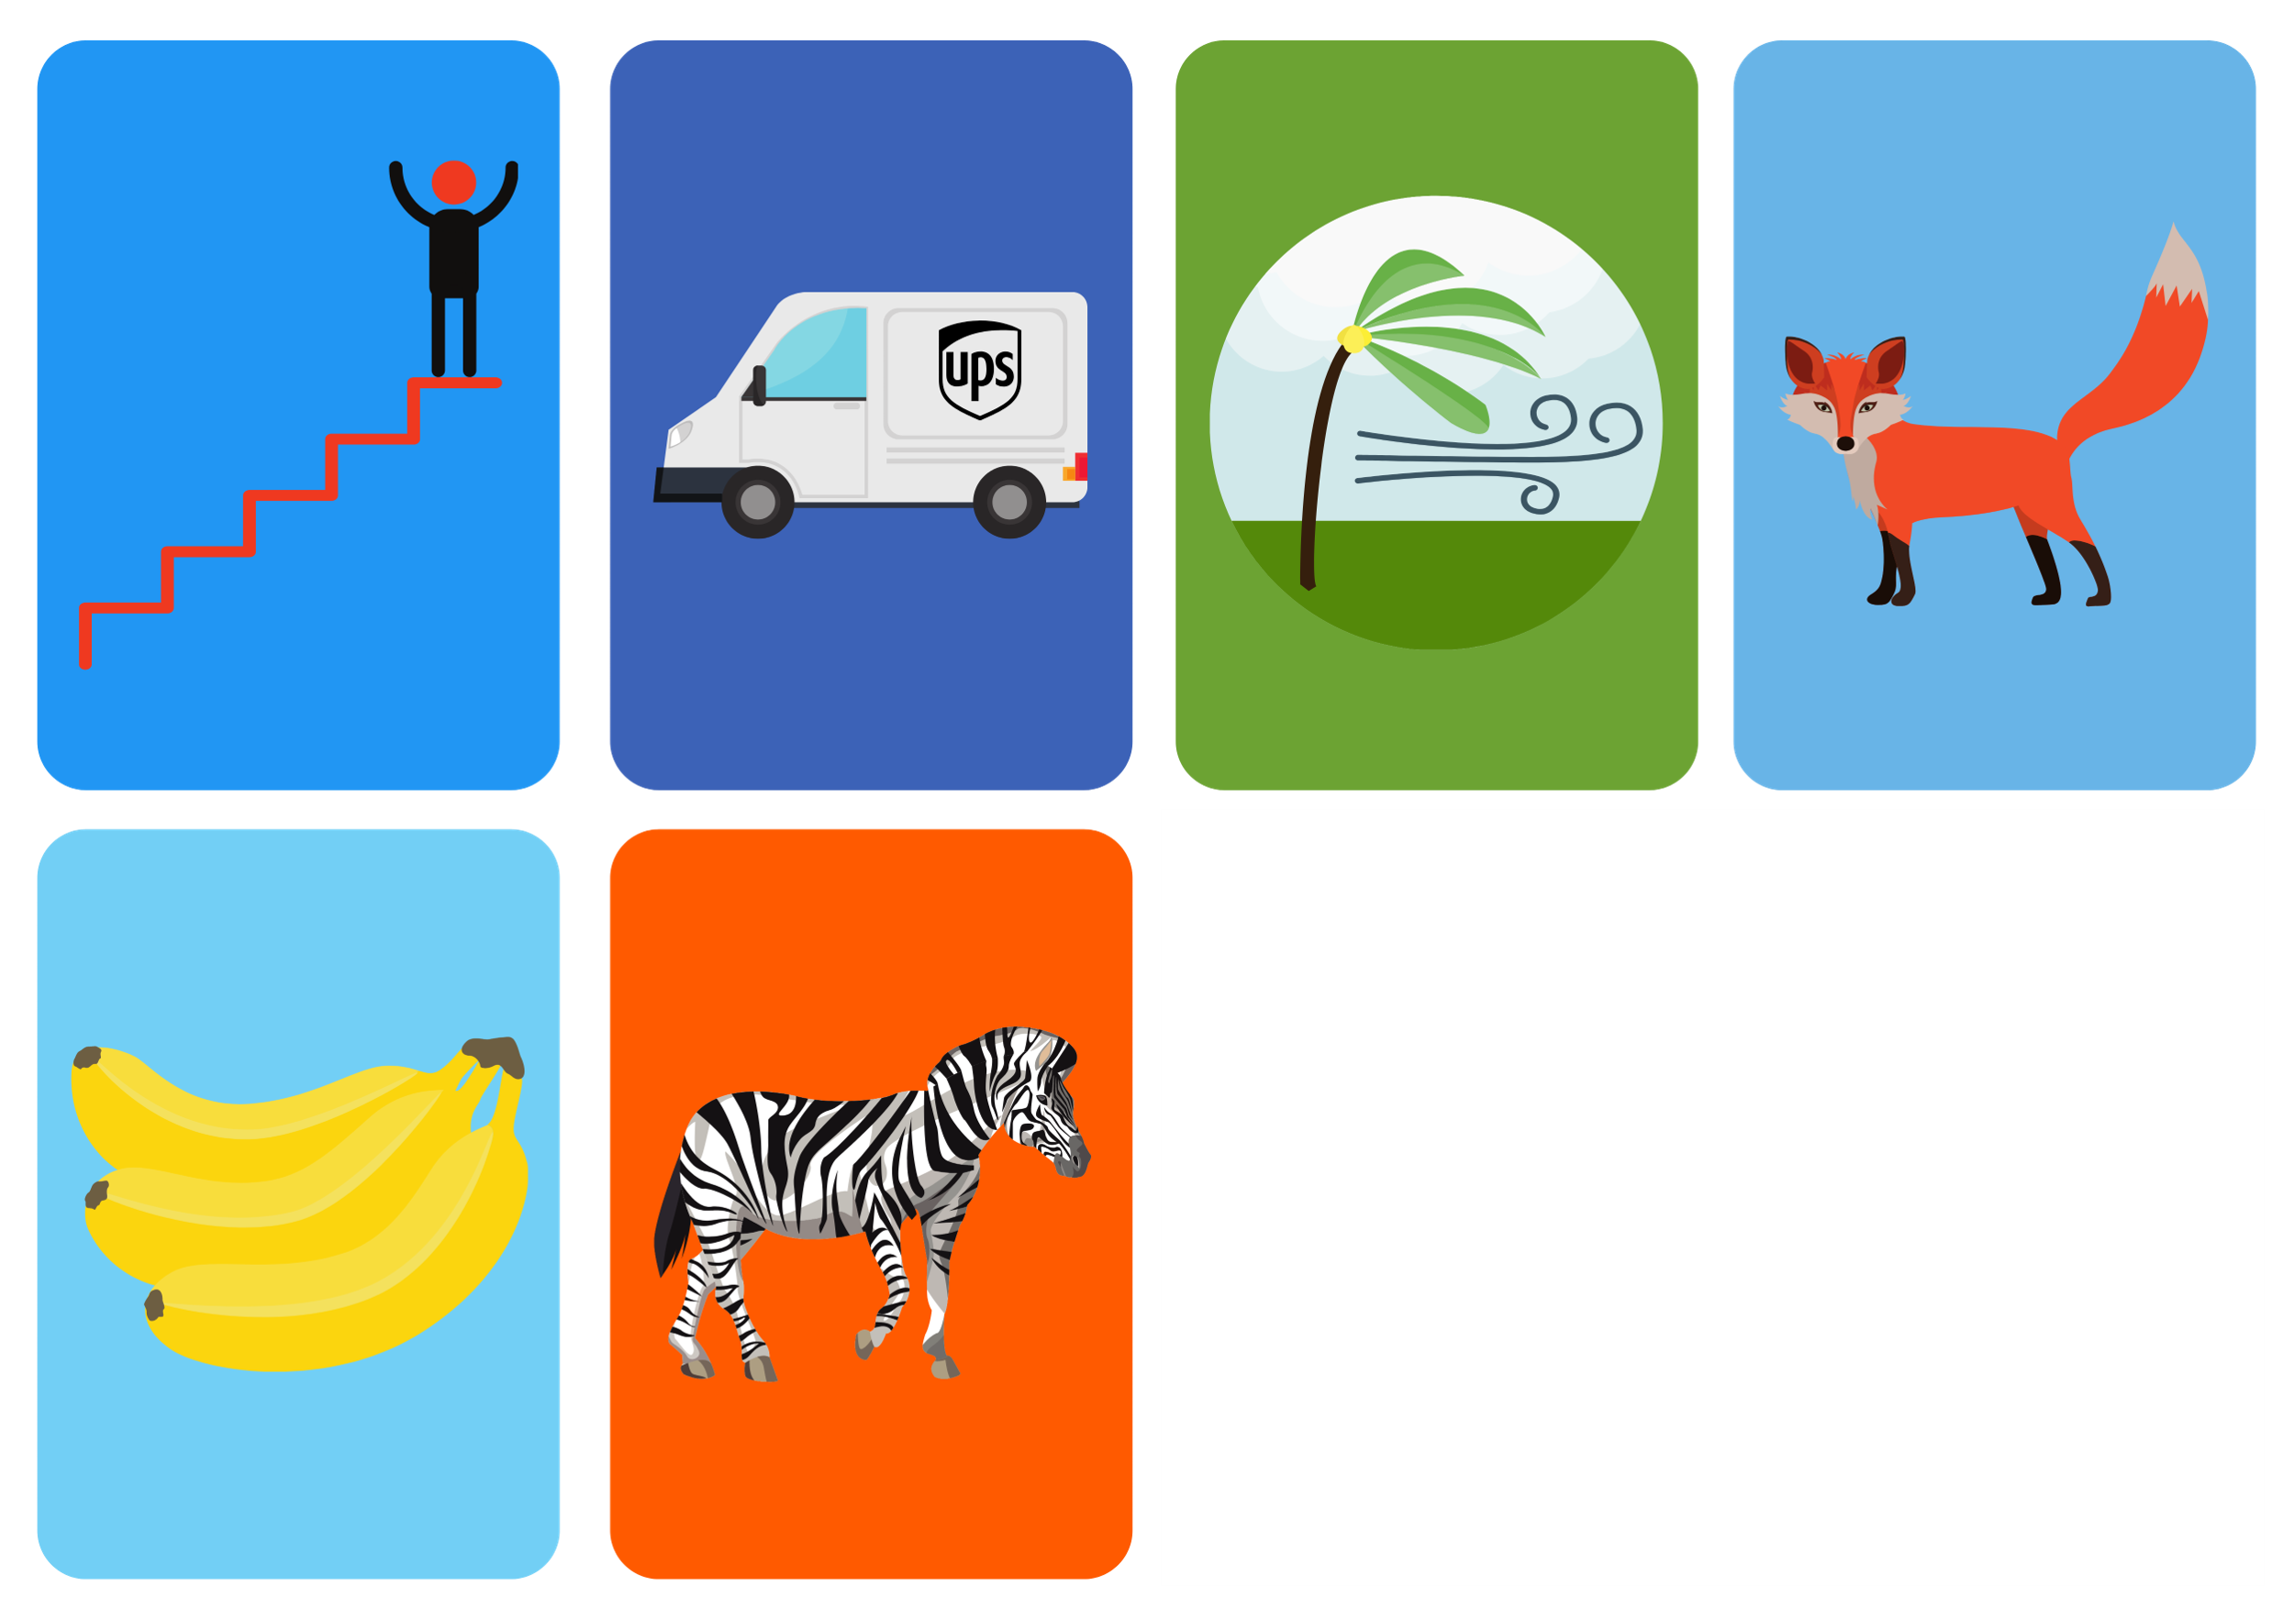
Page 3

